Slide 1
Sri Krishnadevaraya University College of Engineering and Technology, Anantapur
Andhra Pradesh-515003
Road Lane Detection with Assistance
Team Members
Under the Esteemed Guidance
1. Madakam Haritha-2010123
2. Kolimi Imamulhaq-2010122
3. Sake Koteswari-2010141
Smt. D. Gousiya Begum M.Tech, (Ph.D.)

Slide 2

Course Outline
Abstract
Problem Statement
Existed Solution
Proposed Solution
Algorithm & Deployment
Future Scope
Conclusion
References

Slide 3
Abstract
The Lane Detection Project focuses on developing a computer vision system to identify and track lanes on roadways. Leveraging image processing techniques, the system aims to enhance autonomous vehicle navigation and improve driver assistance systems. By analyzing input from cameras or sensors, the algorithm detects lane boundaries, providing crucial information for vehicle control and safety. The project’s abstract highlights its significance in advancing intelligent transportation systems and ensuring safer and more efficient road travel.

Slide 4
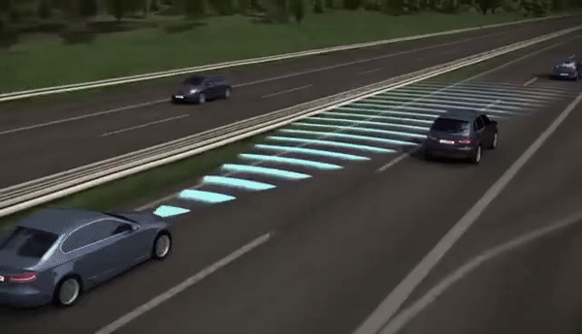
Problem Statement
Conventional lane detection systems lack robustness in complex driving environments, leading to unreliable assistance for drivers. Variations in lighting conditions, road markings, and environmental factors challenge the accurate identification of lane boundaries.
This inconsistency poses risks for autonomous driving systems and driver assistance technologies, potentially causing accidents or misinterpretations of road conditions.
Therefore, there is a pressing need for an advanced lane detection system that can reliably assist drivers by accurately identifying lane boundaries under diverse real-world conditions.

Slide 5
Existing Solution
Lane detection, crucial for autonomous vehicles, often employs OpenCV, a library offering image processing tools.
The process starts with image capture and preprocessing to enhance lane visibility.
Edge detection algorithms like Canny identify potential lane markings, refined within a region of interest (ROI) using the Hough transform to detect straight lines.
Post-processing filters out irrelevant lines and smooths lane boundaries. Evaluation metrics ensure detection accuracy.

Slide 6
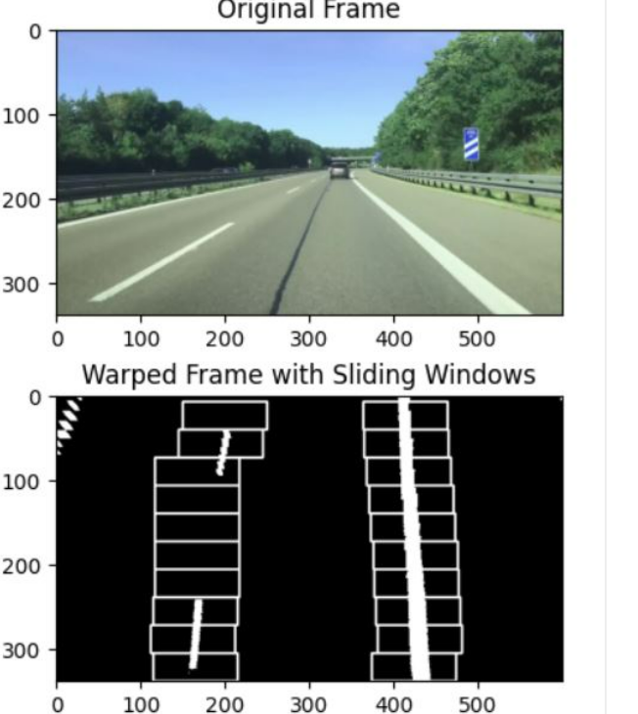
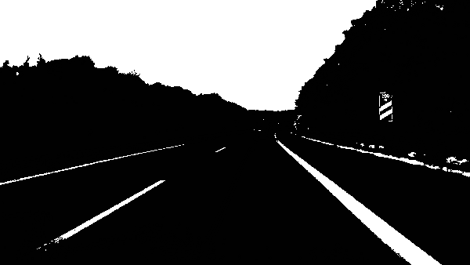
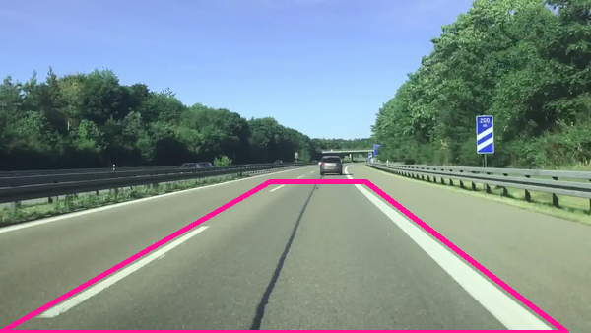
Proposed Solution
The proposed solution offers several advantages over traditional methods, including higher accuracy, robustness to challenging conditions, and adaptability to different road scenarios.
Isolate Pixels That Could Represent Lane Lines
Apply Perspective Transformation to Get a Bird’s Eye View
Set Sliding Windows for White Pixel Detection

Slide 7
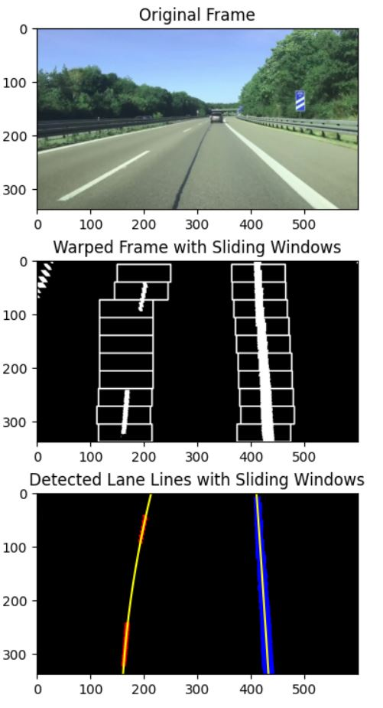
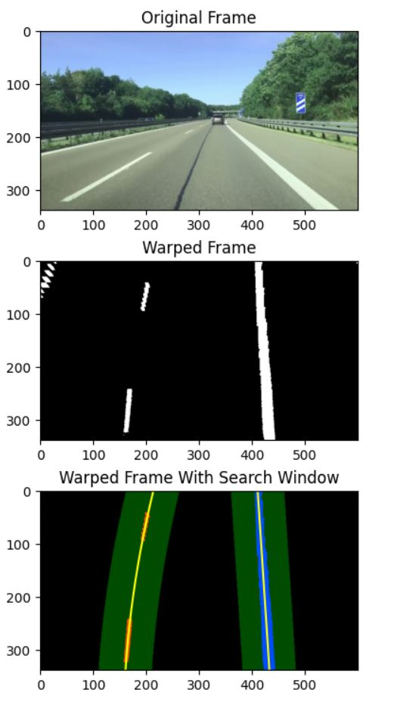
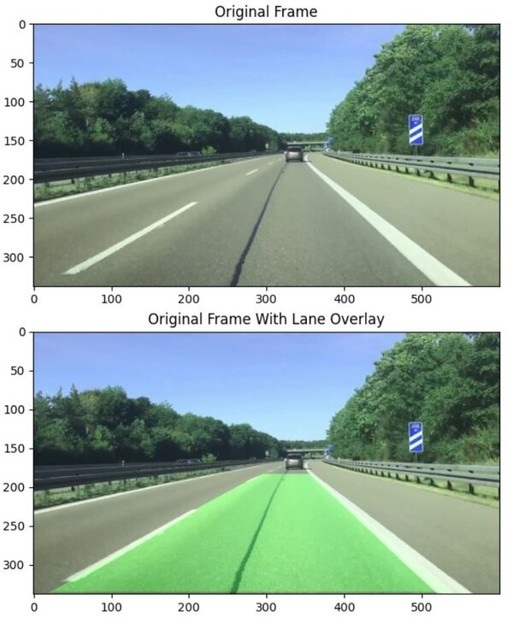
Here is an Example for a input image and respected output image shows that how lanes can be detected on the road.

Slide 8
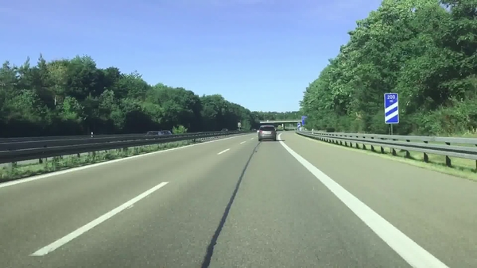
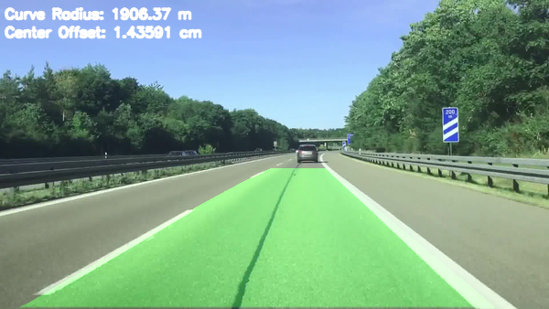
The INPUT Image
Here is OUTPUT Image

Slide 9
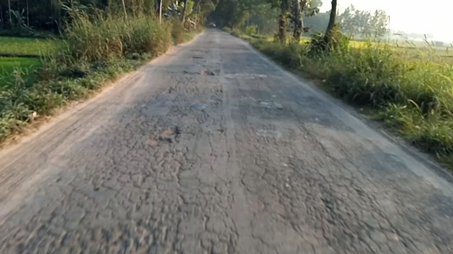
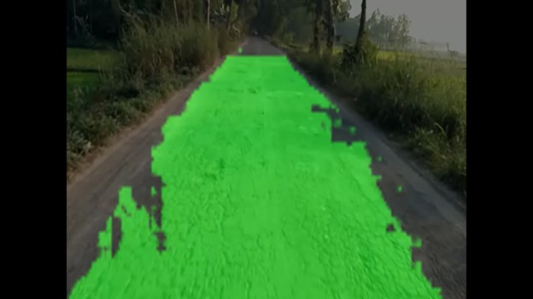
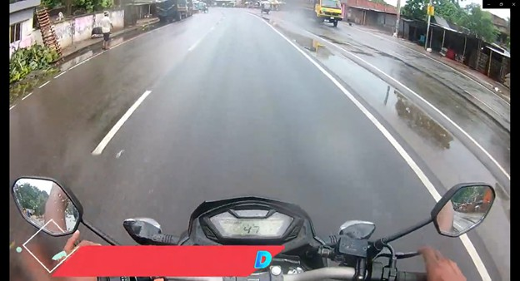
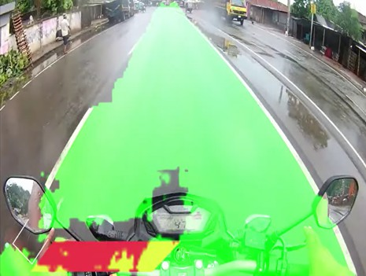
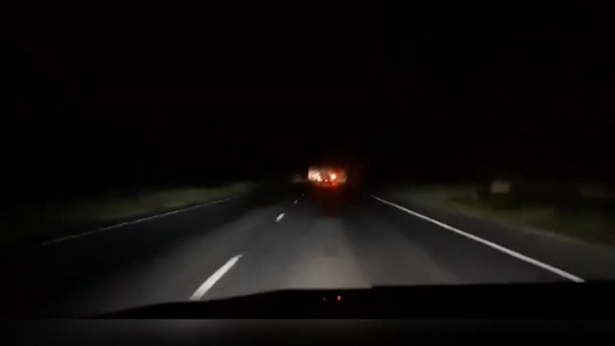
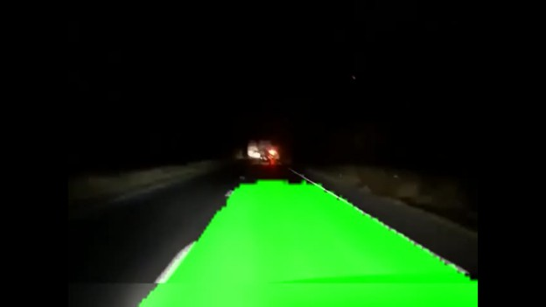
Frames Detected Frames

Slide 10






Algorithm & Deployment
Input Data:
OpenCV: Process images and videos.
Docker: Containerize the application.
Matplotlib: Create visualizations.
Moviepy: Edit videos.
Flask Application:
Receives input data.
Processes data using OpenCV, Docker, Matplotlib, and Moviepy.
Generates an output application.
Output Application:
Deployed on Azure Cloud.

Slide 11
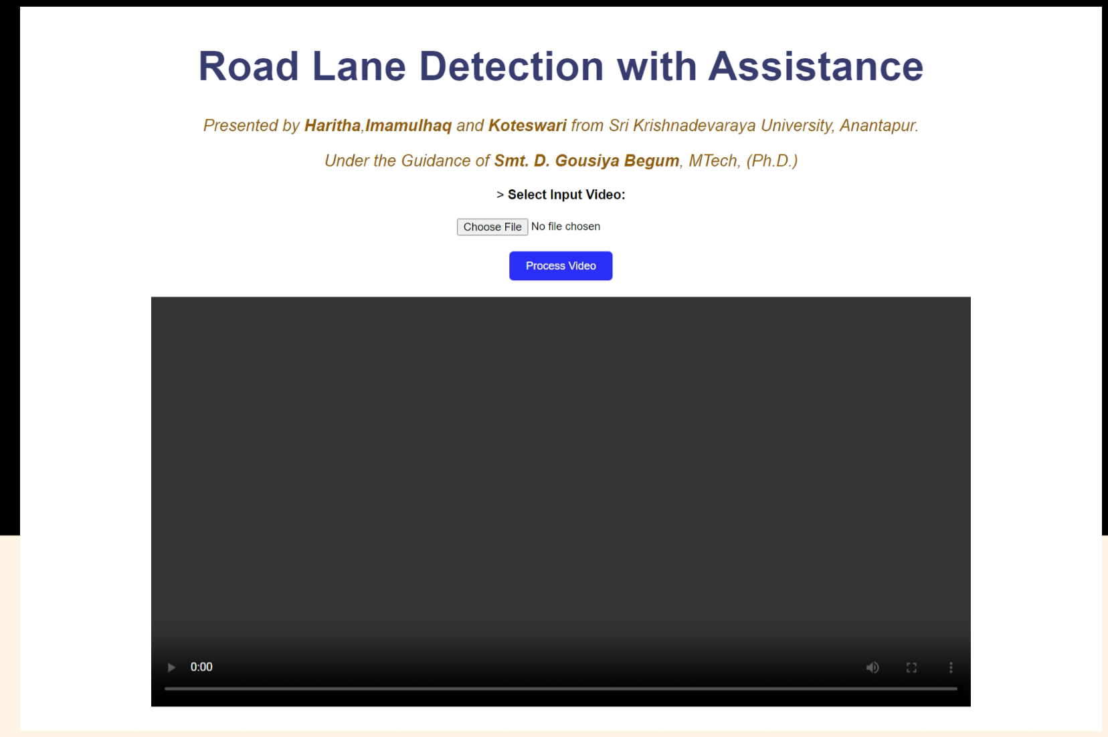
Application Screenshots

Slide 12
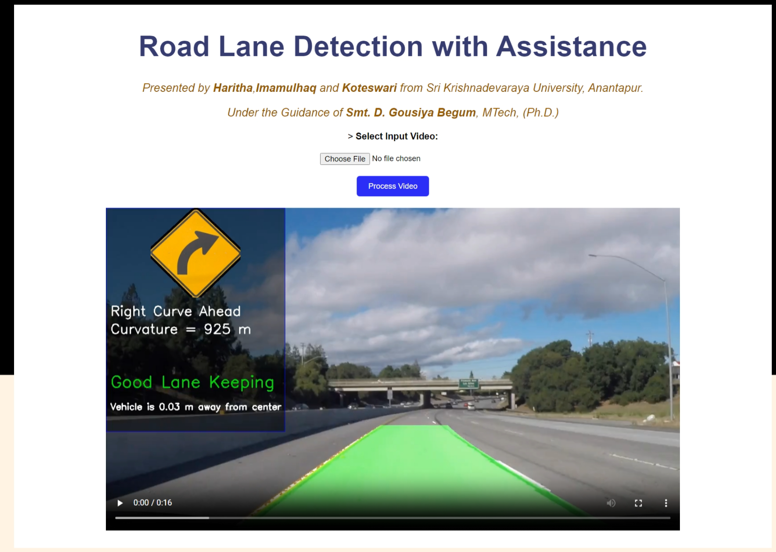
Application Screenshots

Slide 13

Future Scope
Advanced Autonomous Vehicles
Multi-Lane and Complex Road Scenarios
Real-time Traffic Management
Notes:
13

Slide 14

Conclusion
In conclusion, the lane detection project addresses the critical need for advanced computer vision solutions in autonomous vehicles and driver assistance systems.
Notes:
14

Slide 15
Reference
https://automaticaddison.com/the-ultimate-guide-to-real-time-lane-detection-using-opencv/
https://www.youtube.com/watch?v=iRTuCYx6quQ
https://colab.research.google.com/drive/1NJ6dLmSaRMnTqIYUTmzSmzPvQSsJRul#scrollTo=V6LhSijAc4a-
Notes:
Reference
These are the references for this session.

Slide 16
Thank you!
Notes:
16

